Slide 1
Leads Scoring Case Study
To create a Logistic Regression Model to determine whether ran education company's lead for online courses the conversion of designated X Education would be successful or not.
By:-
Vasvi Bhangalia
Ashish Prasad Maharana

Slide 2
Sub Objectives
A Logistic Regression model which predicts the conversion probabilities of each lead.
Decide a threshold value, which denotes whether a lead probabilistic value will be classified as converted or not , depending whether the lead probabilistic value is greater than or lower than threshold value.
Multiply the Probability of each respective lead to get a Lead Score value

Slide 3
Problem Solving Methodology
Basic Understanding of the Data
Data Preparation And Cleaning
Eliminate features possessing multicollinearity issues using VIF method and looking at their p-values
Building the model, and ,using RFE to find the best performing features
Model Evaluation, looking at various metrics to know whether the model is good or bad.
Deciding the Probability threshold value based on optimal cut off point and predict the dependent variable for the training data
Use the Model for prediction on the test dataset and perform model evaluation for the test set.

Slide 4
Data Preparation & Feature Engineering
The Following data preparation processes ere applied to make the data dependable so that it can provide significant business value by improving Decision making process:

Slide 5
Deleting Redundant columns
Columns with Single Value, i.e Receive More Updates About Our Courses(only no),Update me on Supply Chain Content,I agree to pay the amount through cheque,Magazine,Get updates on DM Content were deleted because they contained only one value and not help in predicting cases.
Removing Rows where columns have high missing values
Columns Asymmetrique Activity Index, Asymmetrique Profile Index , Asymmetrique Activity Score, Asymmetrique Profile Score , Lead Quality were having null values with null values greater than 40% hence were deleted.
Imputing NULL values with mode values
Lead Profile , What is your current occupation, What matters most to you in choosing a course , Country , Last Activity, Lead Source where null values are replaced with mode values
Imputing NULL values with median values
TotalVisits , Page Views Per Visit were columns where NULL values are replaced with median values.

Slide 6
Removing unnecessary columns
Country, What matters most to you in choosing a course, Last Notable Activity , Last Activity,Tags were dropped because they were not giving
Handling ‘Select’ values in columns
Lead Profile , How did you hear about X Education, Specialization , City Select values were lumped with NULL values and imputed with values unique to their categories.
Handling Categorical columns with either Yes/No values 0/1
Dummy Encoding
For the following categorical variables with multiple values, dummy features were created
Lead Origin, Lead Source ,TotalVisits, Page Views Per Visit , Last Activity , Specialization, How did you hear about X education,, hat is youtr current occupation, tags, Lead Profile, City
Binary Encoding
A free copy of Mastering The Interview, Through Recommendations, Digital Advertisement , Newspaper , Newspaper Article, X Education Forums , Search , Do Not Email, Do Not Call were converted to 0/1.

Slide 7
Test- Train Split
The original dataframe was split into Test and test dataset. The train dataset was used to train the model and test dataset was used to evaluate the model.
Feature Scaling
Scaling helps in interpretation. It is important to have all variables ( specially the categorical features ) on the same scale for the model to be easily interpretable.
Standardisation was used to scale the data for modelling. It basically brings all of the data into a standard normal distribution with mean at zero and standard deviation one.

Slide 8
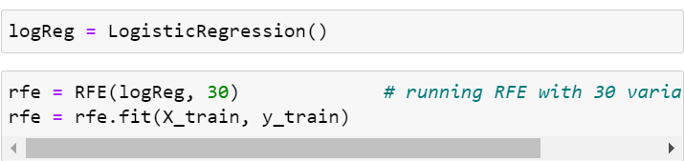
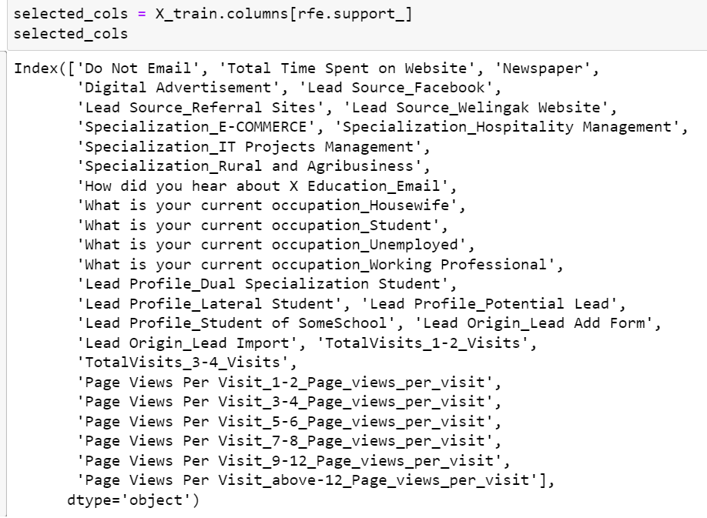
Recursive Feature Elimination is an optimization technique for finding the best performing subset of features. It is based on the idea of repeatedly constructing a model and choosing either the best sets of features aside and then repeating the process with the rest of the features. This processes is applied until all the features in the datset are exhausted. Features are then ranked according to hen they were eliminated.
Running RFE with the output number of the variables equal to 30.

Slide 9
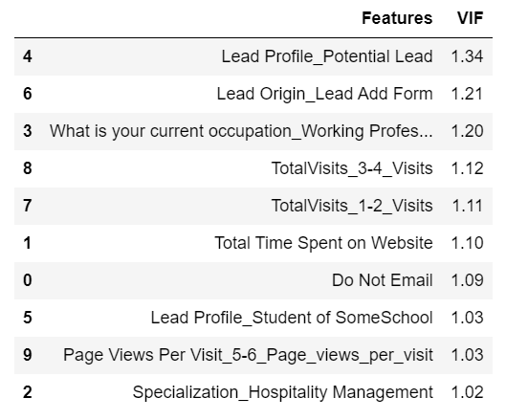
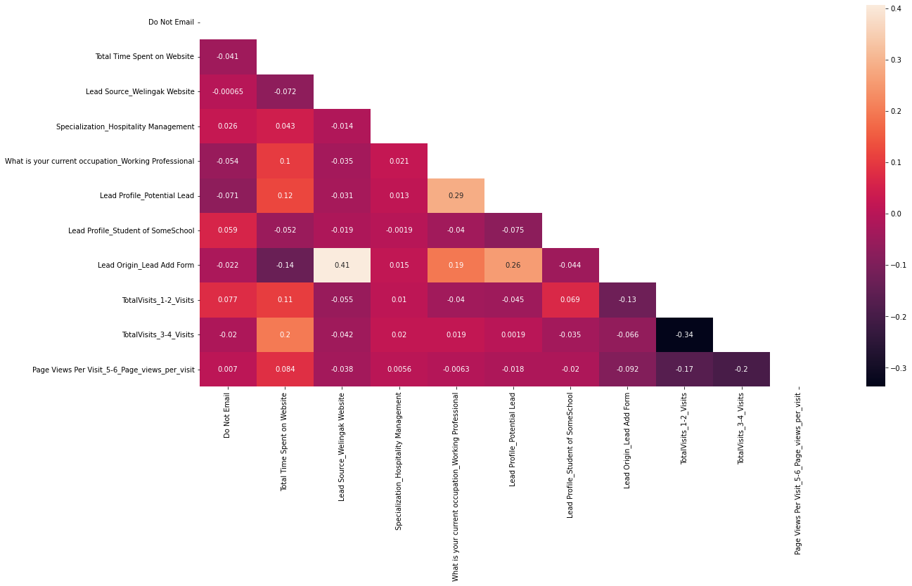
Generalized Linear Models from StatsModel is used to build the Logistic Regression Model
The Model is built initially with the 30 variables selected by the RFE
Unwanted features are dropped serially after checking p values (<0.5) and VIF (<5) and model is built multiplr times
The final model with 17 features, passes botht the significances test and the multi-collinearity test
A heat map consists of final 17 features proves that there is no significant correlation between the independent variables.

Slide 10
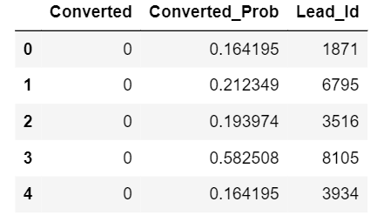
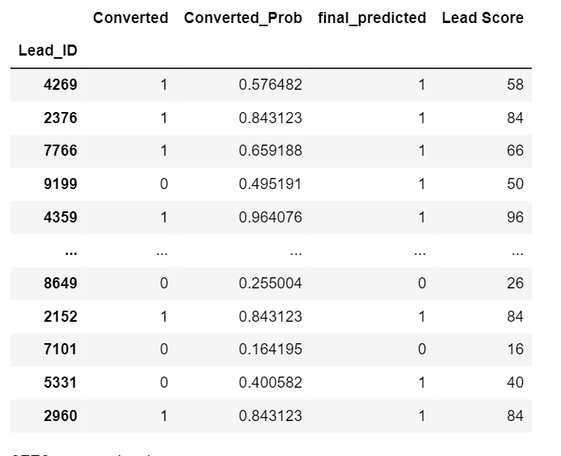
Predicting the Conversion Probability and Predicted Column
Creating a dataframe with the actual Converted Flag and the predicted Probabilities
Showing top 5 record of the dataframe in the picture on the right.
Creating new column ‘Final Predicted’ witrh 1 if Conversion_Prob>0.5 else 0
Showing all the records of the dataframe in the picture on the left.

Slide 11
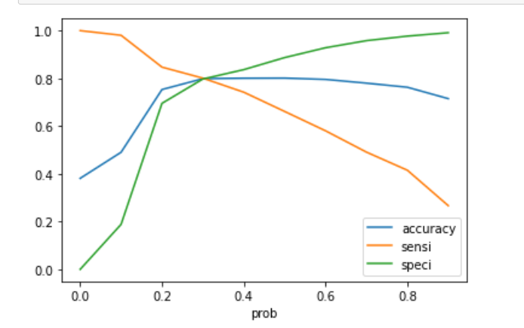
Finding Optimal Probability Threshold
Optimal Probability Threshold
The accuracy ,sensitivity and specificity was calculated for various values of probability threshold and plotted in the graph to the right
For the curve above 0.3 it is found to be the optimum point for cut off frequency.
At this threshold value, all the 3 metrics-accuracy , sensitivity and specificity were found above 80% which is a well accepted value

Slide 12
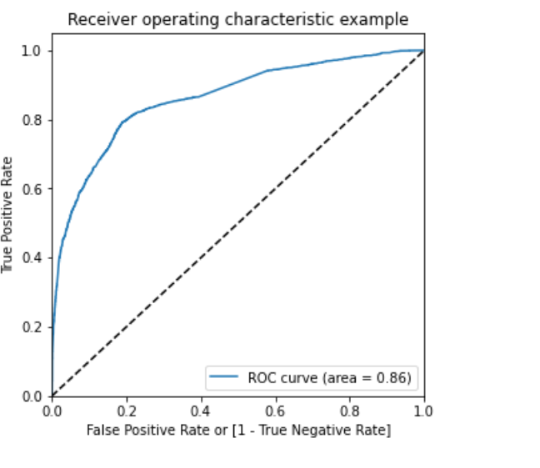
Plotting the ROC Curve & Calculating AUC
Receiver Operating Characteristics (ROC) Curve
It Shows the tradeoff between sensitivity and specificity
Area under the curve (GINI)
By determining the area under the curve of the ROC curve, the goodness of the model is determined. Since the ROC curve is more towards the upper left corner of the graph, it means that the model is very good. The larger the AUC, the better will is the model
The value of AUC for our model is 0.86

Slide 13
Evaluating the model on the Train Set
Confusion Matrix
#Predicted Not Converted Converted
#Actual
Not Converted 3191 811
Converted 491 1975
Probability Threshold
= 0.33
Accuracy
79.87
Sensitivity
80.09
Specificity
79.74
Precision
70.89
Recall
80.09

Slide 14
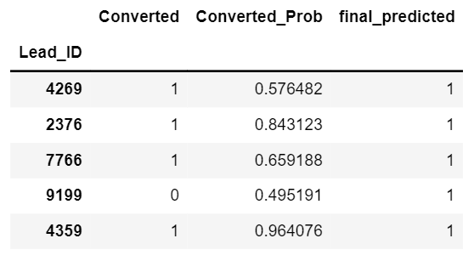
Making Predictions on the test set
The final model on the train dataset is used to make predictions for the test dataset
The train data set was scaled using the scaler transform function that was used to scale the train dataset
The predicted probabilities were added to the leads in the test data frame
Using the probability threshold value of 0.3, the leads from the test dataset were predicted if they will convert or not.

Slide 15
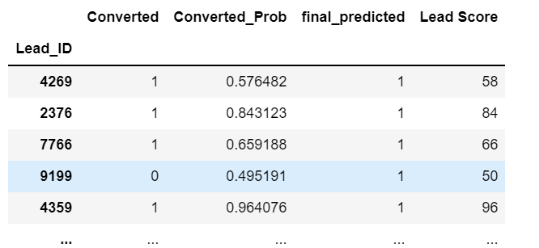
Lead Score Calculation
Lead Score is calculated for all the leads in the original dataframe.
Formula for the Lead Score conversion is:
The train and test data set is concatenated to get the entire list of leads available
The conversion Probability is multiplied by 100 to obtain the lead score for each lead.
Higher the Lead Score, higher is the probability of a lead getting converted and vice versa.
As the threshold value is 0.3. Any lead with a lead score of 30 or above will have a value of 1 in the final predicted column.
Lead Score = 100 * Conversion Probability

Slide 16
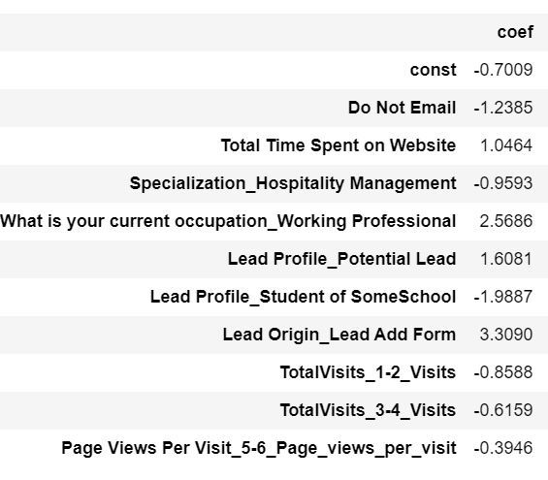
Deciding Feature Importance
A total of 10 features has been used by our model to successfully predict if a lead will get converted or not.
The coefficient values for each of these features from the model parameters are used to determine the order of importance of these features.
Features with high positive beta values are the ones that contribute most towards the probability of a lead getting converted.
Similarly, features with high negative values contribute the least.

Slide 17
Inference
After trying several models , we finally choose a model with the following characteristics:
All variables have a p-value<0.5
All the feature have very low VIF values.
The overall accuracy of 79.87 at a probability threshold of 0.3 on the test dataset is also very acceptable.
Based on our model some features are identified which contribute most to a lead getting converted successfully.
The conversion probability of a lead increases in the values of the following features:- What is your current occupation _Working Professional, Lead Profile _ Potential Lead , Lead Origin _ Lead Add Form
The conversion probability of a lead decreases in the values of the following features:- Do not email,Specialization_Hospitality Management,Lead Profile_student of some school,Toatal Vists_1-2_Visits, TotalVisits_3-4_Visits,Page Views Per Visit_5-6_Page_views_peer_visit

